Slide 1
CONGESSIONAL HOUSE VOTING CLASSIFICATION

Slide 2
Content
Introduction
Process
Analysis
Model Selection
Model Evaluation
Conclusion

Slide 3
MCID Media Company
MCID is a daily newspaper based in New York City with a worldwide readership.
After the 1984 Congressional house voting. The records were made public by the CQA in the later years.
The data included votes for each of the U.S. House of Representatives Congressmen on the 16 key votes identified by the CQA.
The CQA lists nine different types of votes: voted for, paired for, and announced for (these three simplified to yea (Y), voted against, paired against, and announced against (these three simplified to nay (N), voted present, voted present to avoid conflict of interest, and did not vote or otherwise make a position known (these three simplified to an unknown disposition (?).

Slide 4
Problem Statement
The objective was to classify the congressmen as either democrat or republican.
The classification was based on their votes in the 16 bills or key votes.

Slide 5
The Process

Slide 6
Data Exploration and processing
Data Analysis and Evaluation
Data Modelling
Performance Evaluation
Results Evaluation

Slide 7
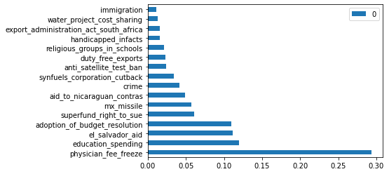
The graph above illustrates feature importance
As seen on the graph above physician fee freeze impacted the classification of the target to a greater extent than the others. As also seen above, the classification problem had four important features.

Slide 8
Feature importance
The feature importance analysis was done using extra trees classifier.
Random Forest chooses the optimum split while Extra Trees chooses it randomly.

Slide 9
Analysis
The dataset was multi-variate. The target feature was a bivariate.
All the features/columns were object data types and were converted to categorical
After the data was split into train and test, the target feature was encoded using label encoding and the rest of the features using ordinal encoding.

Slide 10
Analysis
PCA test was also carried out to maximize variance. without information loss.
Robust scaling was done because it improves classification data.
Oversampling was done because the dataset is small in nature.

Slide 11
Choosing The Model
Classification models were used to solve problem.
All the models were fitted to both the train and test sets.
Decision Tree and Random forest had the highest train scores.
KNeighbors and Random forest had the highest test scores.

Slide 12
Model Selection
After crossing validating the model algorithms, Logistic Regression had the highest train and test score.
In conclusion, the classification problem was done using the Random Forest model because it had a fairly high train and test and cross validation was high as well.

Slide 13
Model Evaluation
After the choosing the model, the performance was evaluated.
The model was fit on the train and test sets and it had an accuracy of 95 %.
The model could successfully predict whether the outcome was a democrat or republican.

Slide 14
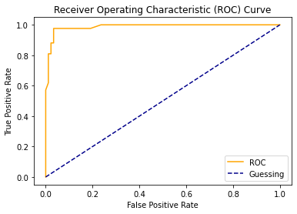
ROC Curve
The graph illustrates that the classifier model being used is not bad. A good classifier is closer to the top left of the ROC.

Slide 15
The ROC had an accuracy score of 0.987 which means it is closer to 1. So the classifier model was near perfect.
According to the classification report, class 0 had 97% accuracy, precision, recall and f1 whereas class 1 had 93%.
Judging by the classification report the model can be useful.

Slide 16
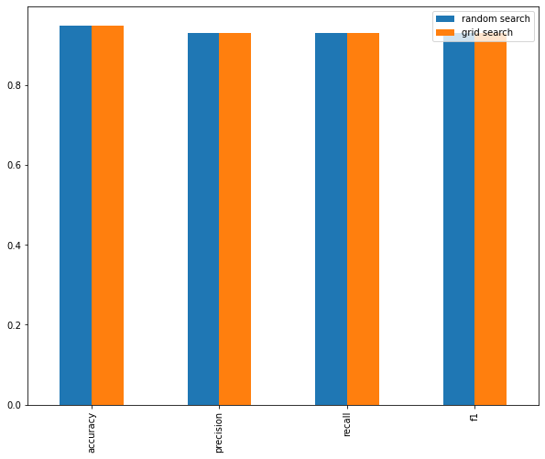
Comparison of hyperparameter tuning models
After tuning the model using Grid Search and Randomized Search, the accuracy scores did not change.

Slide 17
Conclusion
In conclusion, a Random Forest Classifier model was used for the analysis.
The model had a near perfect classification report after the necessary steps were taken.
The model was able to classify the data set using the features.

